Slide 1
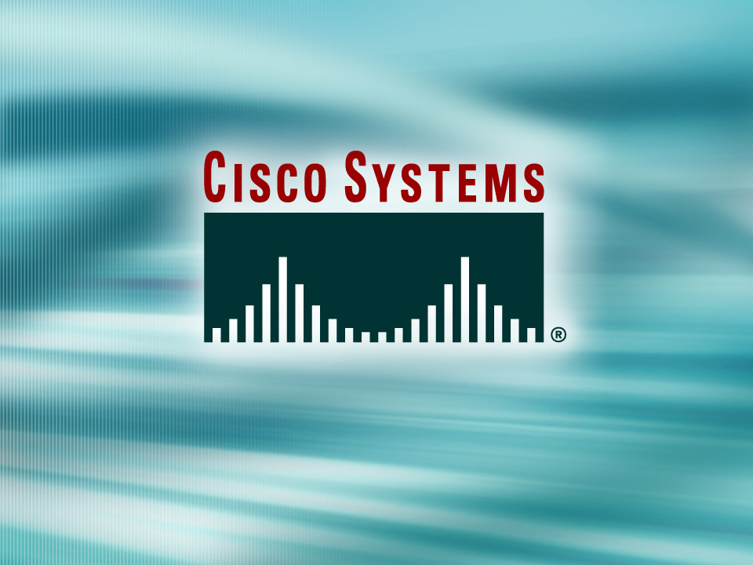
© 2002, Cisco Systems, Inc. All rights reserved.

Slide 2

Spanning-Tree Protocol Overview
© 2002, Cisco Systems, Inc. All rights reserved.
Notes:
Purpose: This chapter introduces the Cisco IOS™ CLI on the Catalyst® 1900 switch and router.
Timing: This chapter should take about 2 hours to present.
Note: The Catalyst 1900 switch only has a subset of the router Cisco IOS commands available.
Contents:
Introduction to Cisco IOS. Explain to the student what is IOS?
Cisco Device startup procedures in general.
IOS configuration source.
General introduction to the IOS CLI.
Cat 1900 switch startup procedures.
Intro to Cat 1900 CLI. This part covers the basic configuration on the switch, like setting the IP address and hostname. More details about the various Cat 1900 switch configuration commands are explained in Chapter 6 and 7.
Router startup procedures. More details on the router startup process is discussed in chapter 5.
Router IOS CLI.

Slide 3
Objectives
Upon completing this lesson, you will be able to:
  Describe the purpose and operation of the STP
  Explain how to implement STP to solve the problems associated with redundant switched
  or bridged topologies
Notes:
Slide 1 of 2
Purpose: This slide states the chapter objectives.
Emphasize: Read or state each objective so that each student has a clear understanding of the chapter objectives.
Note: Catalyst switches have different CLIs. The Catalyst 2900xl and the Catalyst 1900 has a Cisco IOS CLI. The Cisco IOS CLI commands available on the 2900xl is different from the 1900. The Catalyst 5000 family has no Cisco IOS CLI, and use the set commands instead. This class only covers the configuration on the Catalyst 1900 switch.

Slide 4
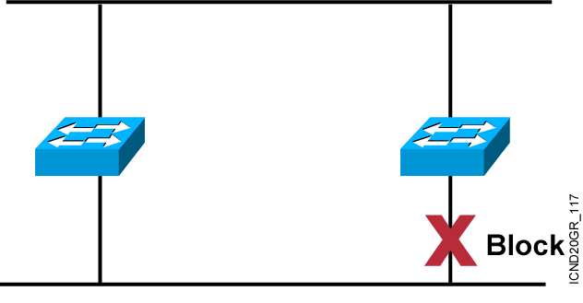
Spanning-Tree Protocol
  Provides a loop-free redundant network topology by
  placing certain ports in the blocking state.
Notes:
Emphasize: A looped topology is often desired to provide redundancy, but looped traffic is undesirable. The Spanning-Tree protocol was originally designed for bridges. Today, it is also applied to LAN switches and routers operating as a bridge. Spanning-Tree protocol ensures that all bridged segments are reachable but any points where loops occur will be blocked.

Slide 5
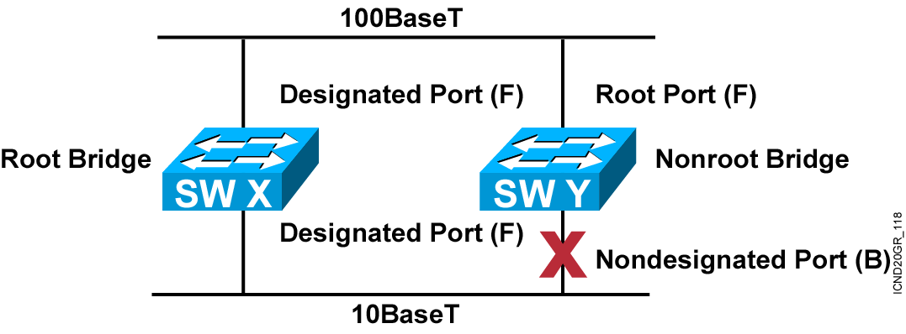
Spanning-Tree Operation
One root bridge per network
One root port per nonroot bridge
One designated port per segment
Nondesignated ports are unused
Notes:
Emphasize: The three general rules when dealing with STP are as follows:
1. One root bridge per network. The root is the bridge with the lowest bridge ID. All the ports on the root bridge are designated ports (forwarding).
2. For every non-root bridge, there is a root port (forwarding). The root port is the port with the lowest accumulated path cost to the root bridge.
3. For every segment, there is only one designated port. The designated port forwards traffic for the segment. The designated port has the lowest accumulated path cost to the root bridge.

Slide 6
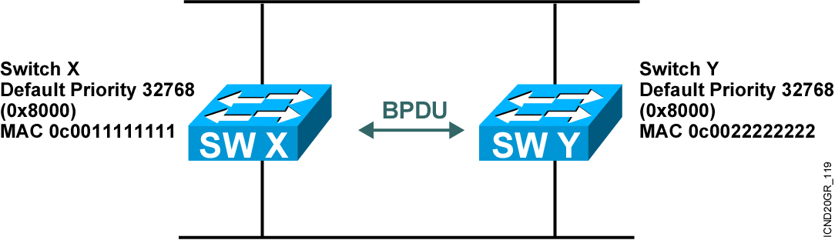

Spanning-Tree Protocol
Root Bridge Selection
Bpdu = Bridge Protocol Data Unit
(default = sent every two seconds)
Root bridge = Bridge with the lowest bridge ID
Bridge ID =
In the example, which switch has the lowest bridge ID?
Notes:
Emphasize: By default, the switch with the lowest MAC address will be the root bridge.
Note: The Catalyst switches support an instance of spanning tree per VLAN. Each VLAN will use a unique MAC address for spanning tree purposes. On the Catalyst 1900, the address it uses for spanning tree is the MAC address on the various ports. VLAN is discussed in the next chapter.
The IEEE 802.1d specification specifies for a 16-bit priority field. The Catalyst 1900 switch only supports the 802.1d Spanning-Tree protocol. The default priority on the Catalyst 1900 is 32768 in decimal or 8000 in hex, the midrange value.
BPDU contain the following fields:
Protocol ID version
Message type
Flags
Root ID
Cost of path
Bridge ID
Port ID
Message age
Max age
Hello time
Forward delay

Slide 7
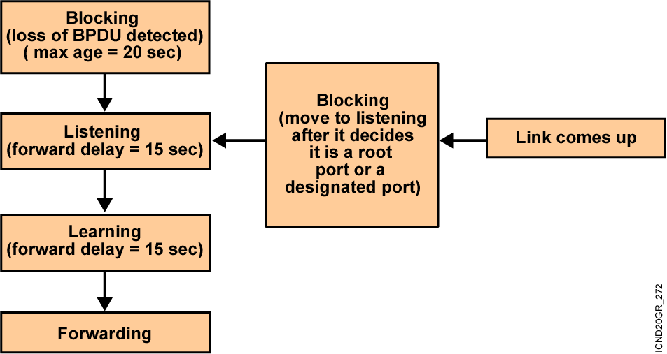
Spanning-Tree Port States
  Spanning-tree transits each port through several different states:
Notes:
Emphasize: Using the default Spanning-Tree protocol timers setting, the times it takes to go from the blocking state to the forwarding state is 50 sec (20 + 15 + 15).

Slide 8
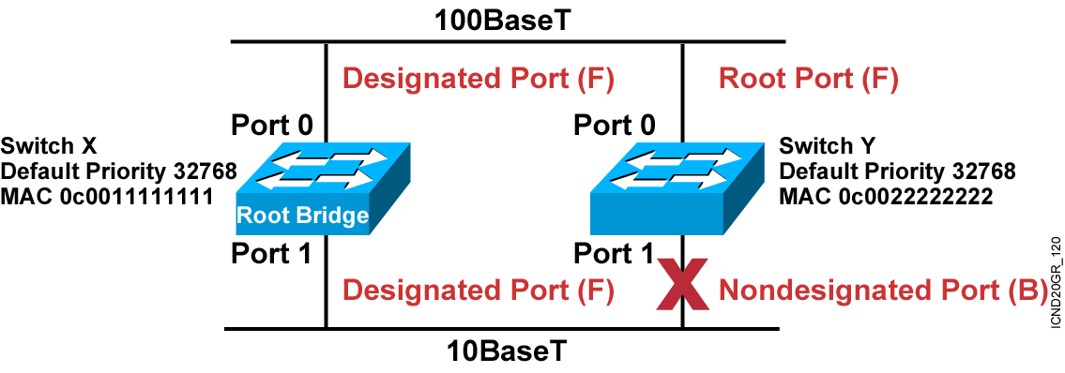
Spanning-Tree Port States (Cont.)
Notes:
Emphasize: RPs and DPs are normally in the forwarding state.
There is only one DP per segment.

Slide 9
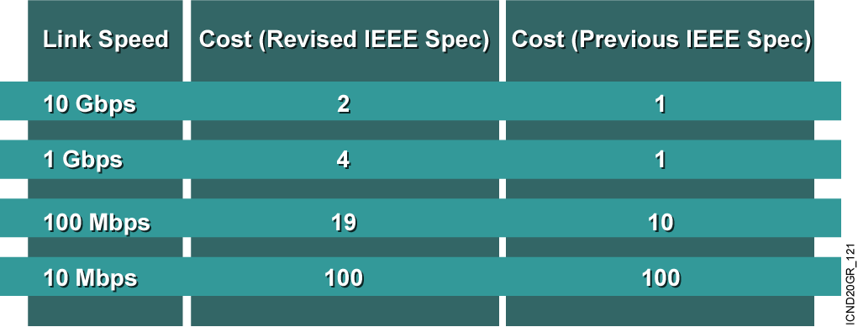
Spanning-Tree Path Cost
Notes:
Emphasize: There are two cost calculation methods. The Catalyst 1900 uses the older method. The new method is designed to accommodate the higher gigabit Ethernet speed.
Note:
Port priority is used to determine which path has preference when path costs are equal (for example, when you have two parallel links connecting two switches together). The default port priority is 128.
The port aggregation protocol and EtherChannels® are not taught in this class.
Fast EtherChannel is supported by the Catalyst 1900 switch.

Slide 10
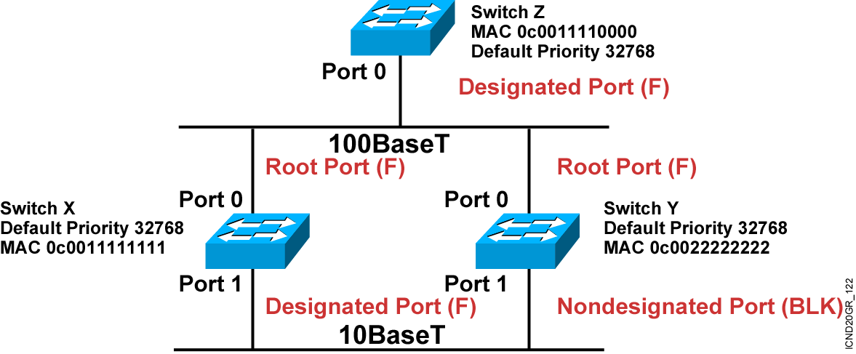
Spanning-Tree Example
Notes:
Layer 2 of 2
Emphasize: Switch X and Y have the same path cost to the root bridge. The DP for the bottom segment is on switch X because switch X has a lower bridge ID than switch Y.

Slide 11
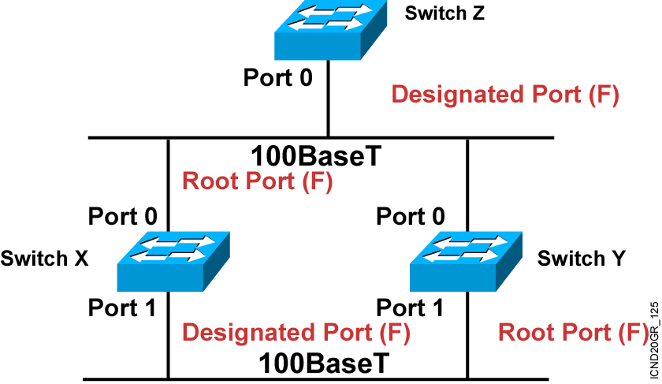
Spanning-Tree Recalculation

Slide 12
Spanning-Tree Convergence
Convergence occurs when all the switch and bridge ports have transitioned to either the forwarding or the blocking state.
When the network topology changes, switches and bridges must recompute the Spanning-Tree Protocol, which disrupts user traffic.
Notes:
Note: In large networks the effect of reconvergence may cause long periods of instability. During the election of a new root, all ports are blocked, and all learned MAC addresses are aged out so that when forwarding again starts, there is a lot of flooding of unicast traffic until the MAC address tables are repopulated. Also if a preferred root and a backup root are not configured by lowering their default priority, then the final topology of the spanning tree may be very inefficient.

Slide 13
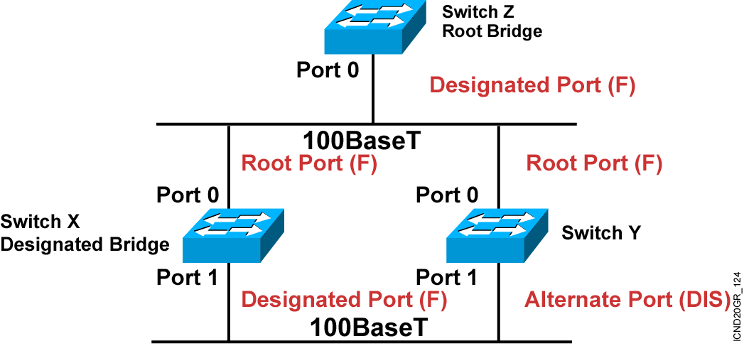
Rapid Spanning-Tree Protocol

Slide 14
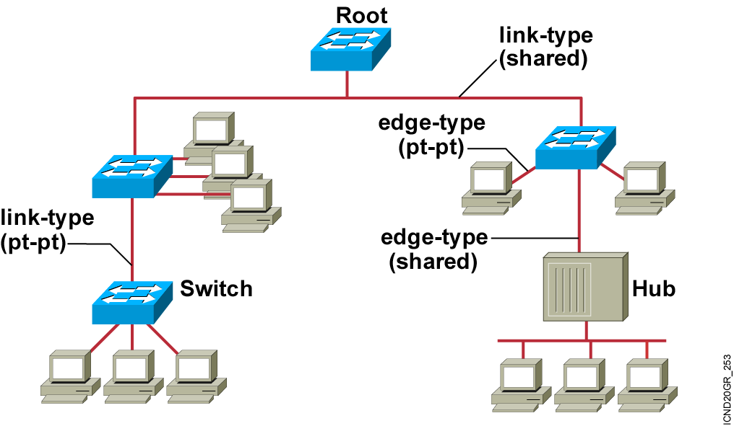
Rapid Transition to Forwarding
Notes:
Slide 2 of 2
Emphasize: What will happen if switch X fails?
Switch Y will detect the missing BPDU from switch X in 20 seconds (max. age timer), then recalculate the Spanning-Tree protocol.
After the network converges, switch Y will be the root bridge, and all its ports will transit to the forwarding states (DP) 30 seconds after the max. age timer expires.

Slide 15
Summary
  STP is a bridge-to-bridge protocol used to maintain a loop-free network.
  STP establishes a root bridge, a root port, and designated ports.
  With STP, the root bridge has the lowest bridge ID, which is made up of the bridge’s priority and MAC address.
  With STP, ports transition through four states: blocking, listening, learning, and forwarding.
  If a change occurs to the network topology, STP maintains connectivity by transitioning some blocked ports to the forwarding state.
  RSTP significantly speeds the recalculation of the spanning tree when the network topology changes.
Notes:
Purpose: This slide discuss the initial configurations on the routers and switches.
Note: There is no setup mode on the Catalyst 1900 switch.

Slide 16


